Slide 1


Analysis on Nature and WildLife Tours in India

Slide 2
Group
Name :- S Sai Akhil
Batch :- 213
Qualification :- B.tech in Electronics and
Communications Engineering.
Work Experience:-1year 8 months at ICICI Bank Ltd as a RelationShip Manager.
Name :- Rukesh Varanasi
Batch :- 213
Qualification :- Masters in Microbiology
Work Experience:- Junior Technical Officer at Sandor Medicaids Pvt Ltd

Slide 3
Agenda
Business Problem and Use Case Domain Understanding
Objective of the Project
Web Scraping – Details (Websites, Processor we followed)
Summary of the Data
Exploratory Data Analysis:
Data Cleaning Steps
Data Manipulation Steps
Univariate Analysis Steps
Bivariate Analysis Steps
Conclusion (Key finding overall)
Your Experience/Challenges working on Web Scraping – Data Analysis Project.

Slide 4
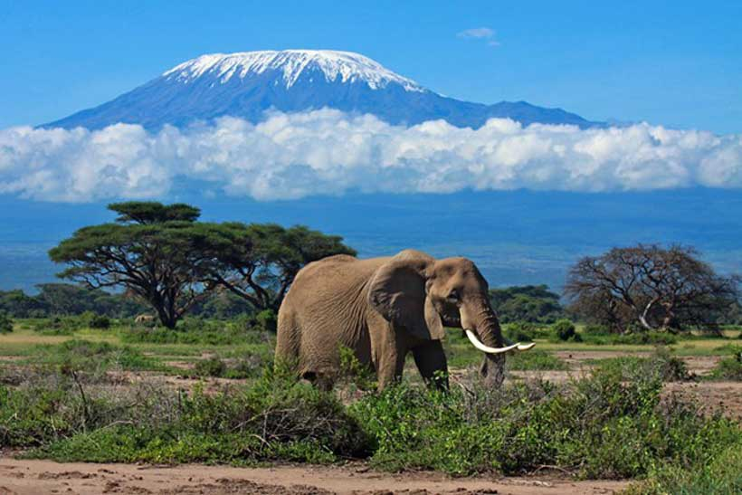

Objective Of The Project
Business Problem and Use Case domain
Best Places for Wild Life Tours and Analysis on various Places based on Reasonable prices.
The main aim of this project is to identifying the Best Nature & Wild Life Tours in India based on the Tour type, Price’s, Rating and No of day’s.

Slide 5
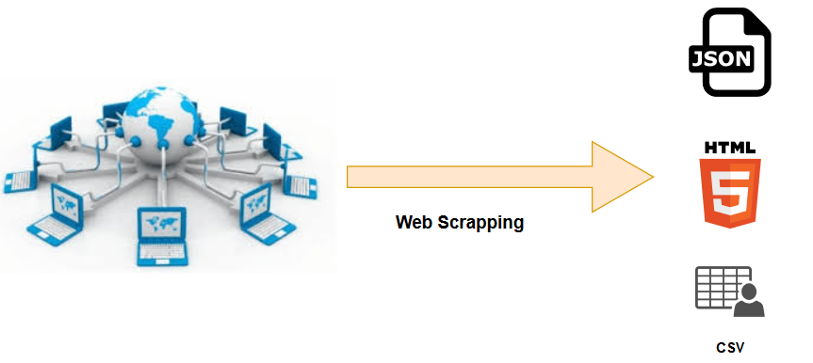
What is WebScrapping ?
Web scraping is an automatic method to collect large amounts of data from websites. Most of this data is unstructured data in an HTML format which is then converted into structured data in spreadsheets or databases so that it can be used in various applications like:
Price Monitoring
News Monitoring
Market Research
Tweets Monitoring
Jobs Monitoring
Working :-
When a web scraper needs to scrape a site, first the URLs are provided.
Then it loads all the HTML code for those sites and a more advanced scraper might even extract all the CSS and JavaScript elements as well.
Then the scraper collects the required data from this HTML code and outputs this data in the format specified by the user.

Slide 6




Libraries used
Requests
Beautiful Soup
Regex (re)
Pandas
Numpy
Matplotlib
Seaborn

Slide 7
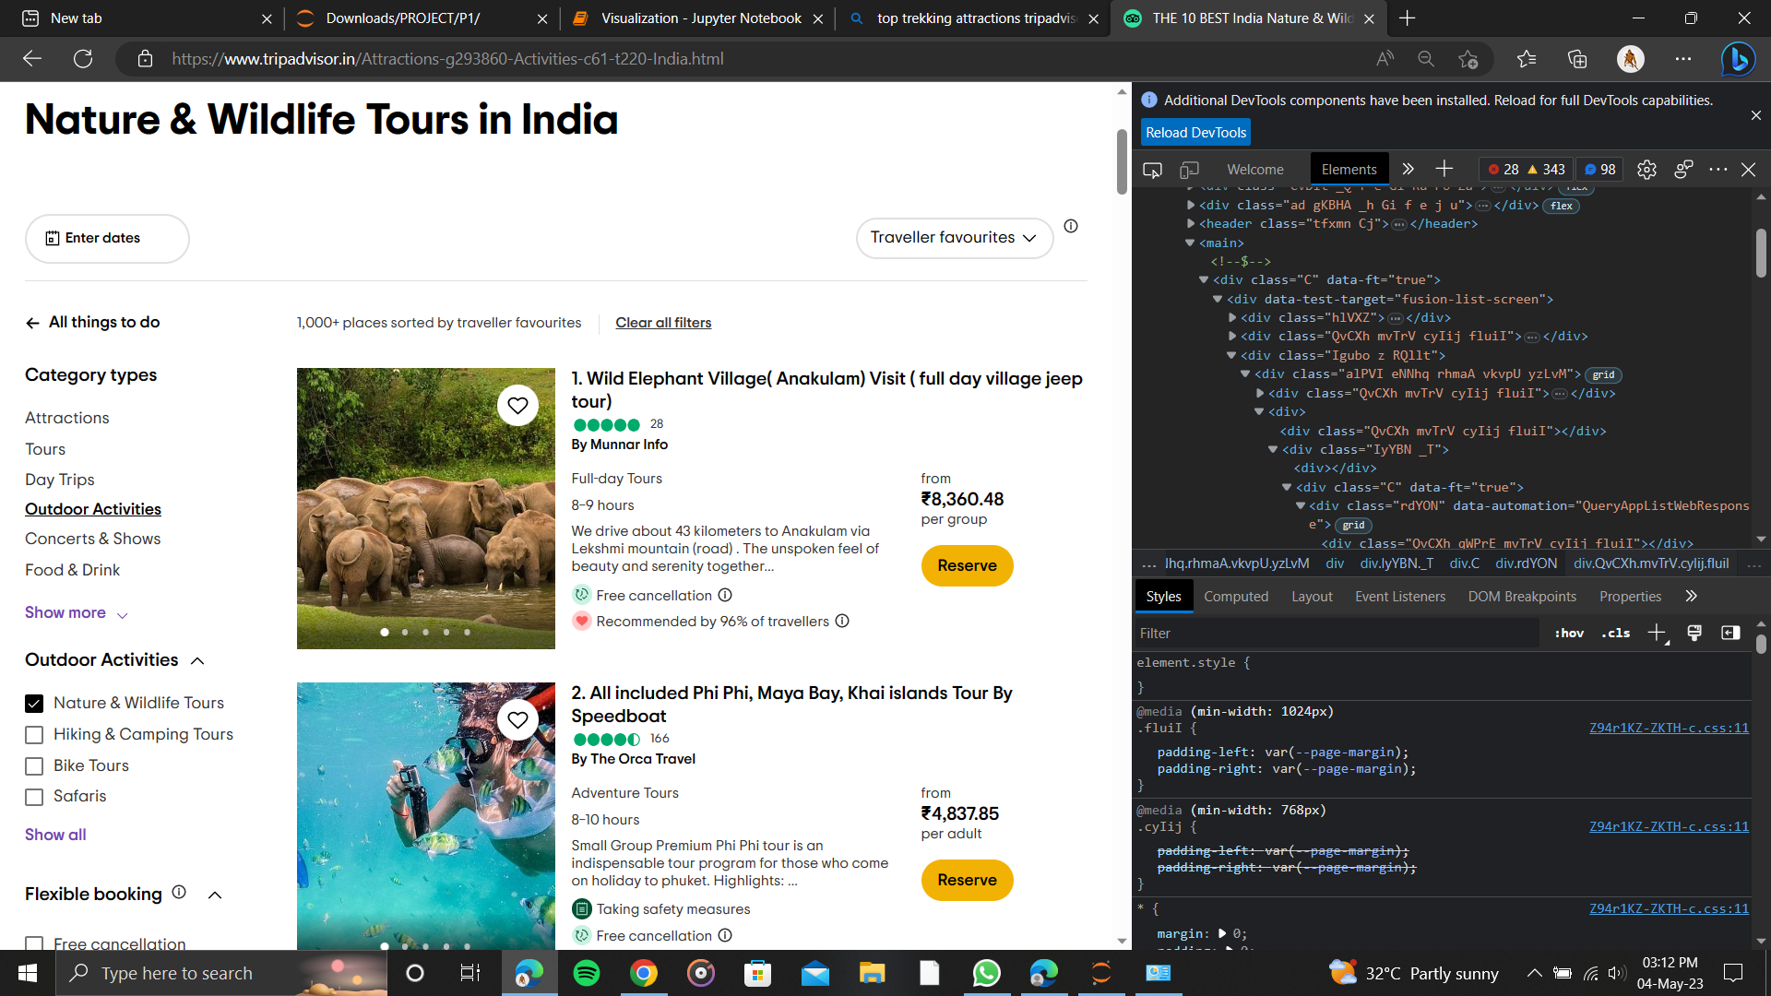
Web Scrapping Details-websites and process we followed

Slide 8
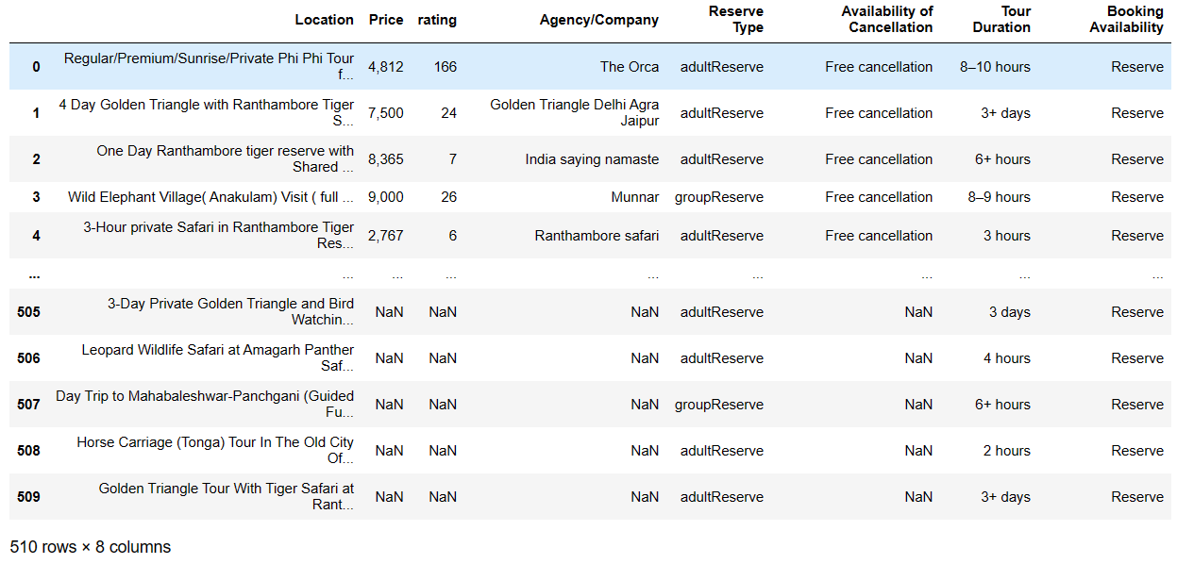
Raw Data

Slide 9

Data Cleaning and Data Manipulation Steps
Removing special characters[(,) from price and (-) from Tour duration columns]
Identifying & imputing missing values.
Dropping of Nan’s(Price, Rating, Agency/company,Availibity of cancellation.
Creating new columns using Lamda function[Rating, Cancellation Charges]
Data Type conversion.

Slide 10
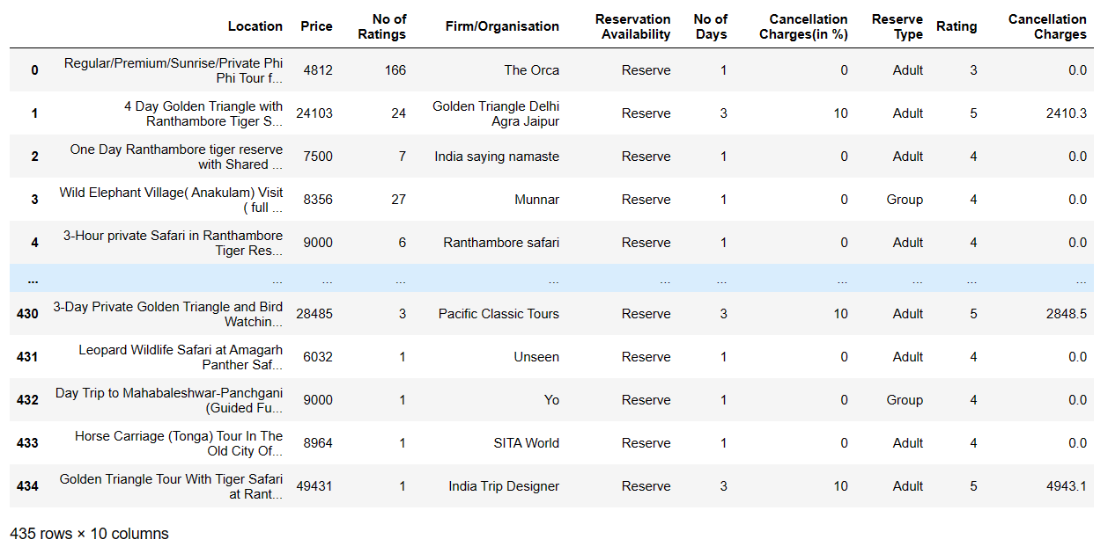
Cleaned Data

Slide 11

Data Visualization
Data visualization is the graphical representation of information and data. By using visual elements like charts, graphs and maps, data visualization tools provide an accessible way to see and understand trends, outliers and patterns in data.

Slide 12
Importance Of Visualization
It promotes the story telling and conveys the right message to the audience.
Explore Business insights and achieve business goals in the right direction.
Absorb vast amounts of data presented in visual formats.
Identifies errors and inaccuracies in data quickly.
Increases the speed of decision making.
Access real- time information and assist in management functions.

Slide 13
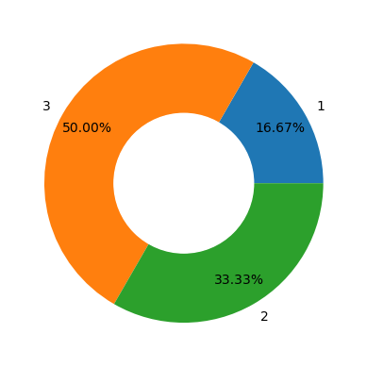
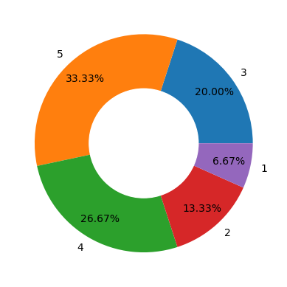
VISUALIZATION
The above Doughnut Chart represents the Percentage for No of day tours (Days:-1,2,3)
The above Doughnut chart represents the Percentage of ratings (Ratings:-1,2,3,4,5)

Slide 14
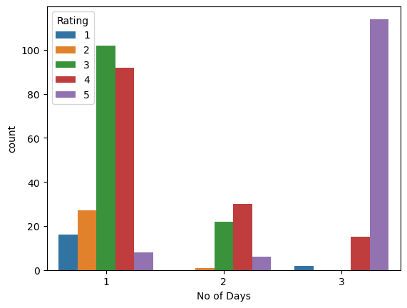
VISUALIZATION
Count plot on No of Days Vs Rating
The above Graph Depicts that the 3 day tours has highest no of 5 star ratings ,and the 2 day tours has highest no of 4star Ratings.
For the 1 Day tours 3 star ratings are higher.

Slide 15
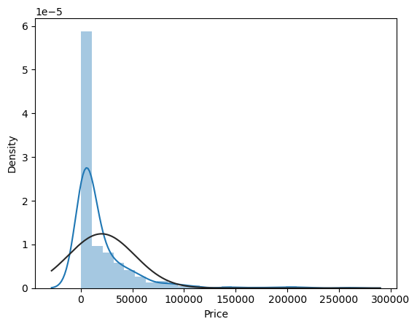
VISUALIZATION
DistPlot on Price
The price range of Normal Distribution above is typically Between 0 and 50,000 with Maximum price of 2,60,000.

Slide 16
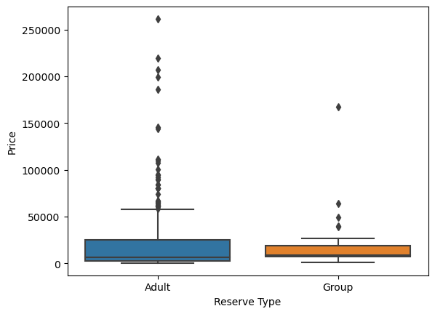
VISUALIZATION
Box Plot on Price Vs Reserve Type
As per the above Box plot the price for the adult Reserve group is more as compared to Group reserve, hence the no of outliers are more in case of Adult Reserve as compare to Group Reserve

Slide 17
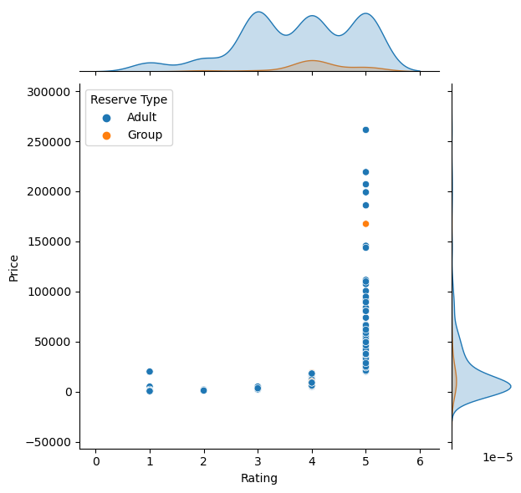
VISUALIZATION
Joint Plot on Price vs Rating and Reserve Type
The Normal Distribution curve above shows that the price for adult reserve is more as compared to group Reserve.
The price range for Adult reserve type is more in range of 0-50,000 as compared to group Reserve.

Slide 18
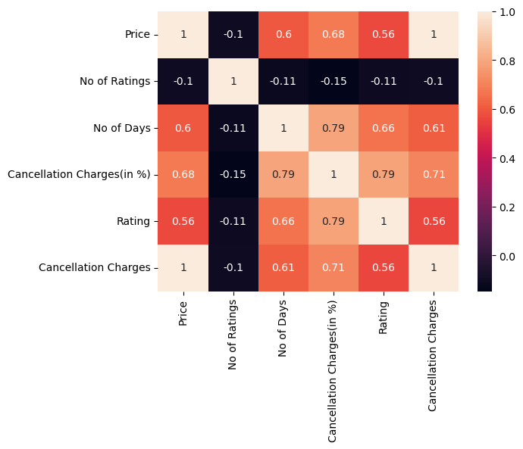
Visualization
Heat Map
From the above heat map we can analyze :
+ve correlation can be seen by increase in the cancellation charges followed by increase in the Rating.
-ve correlation can be seen by decrease in the No of Ratings by Cancellation charges.

Slide 19
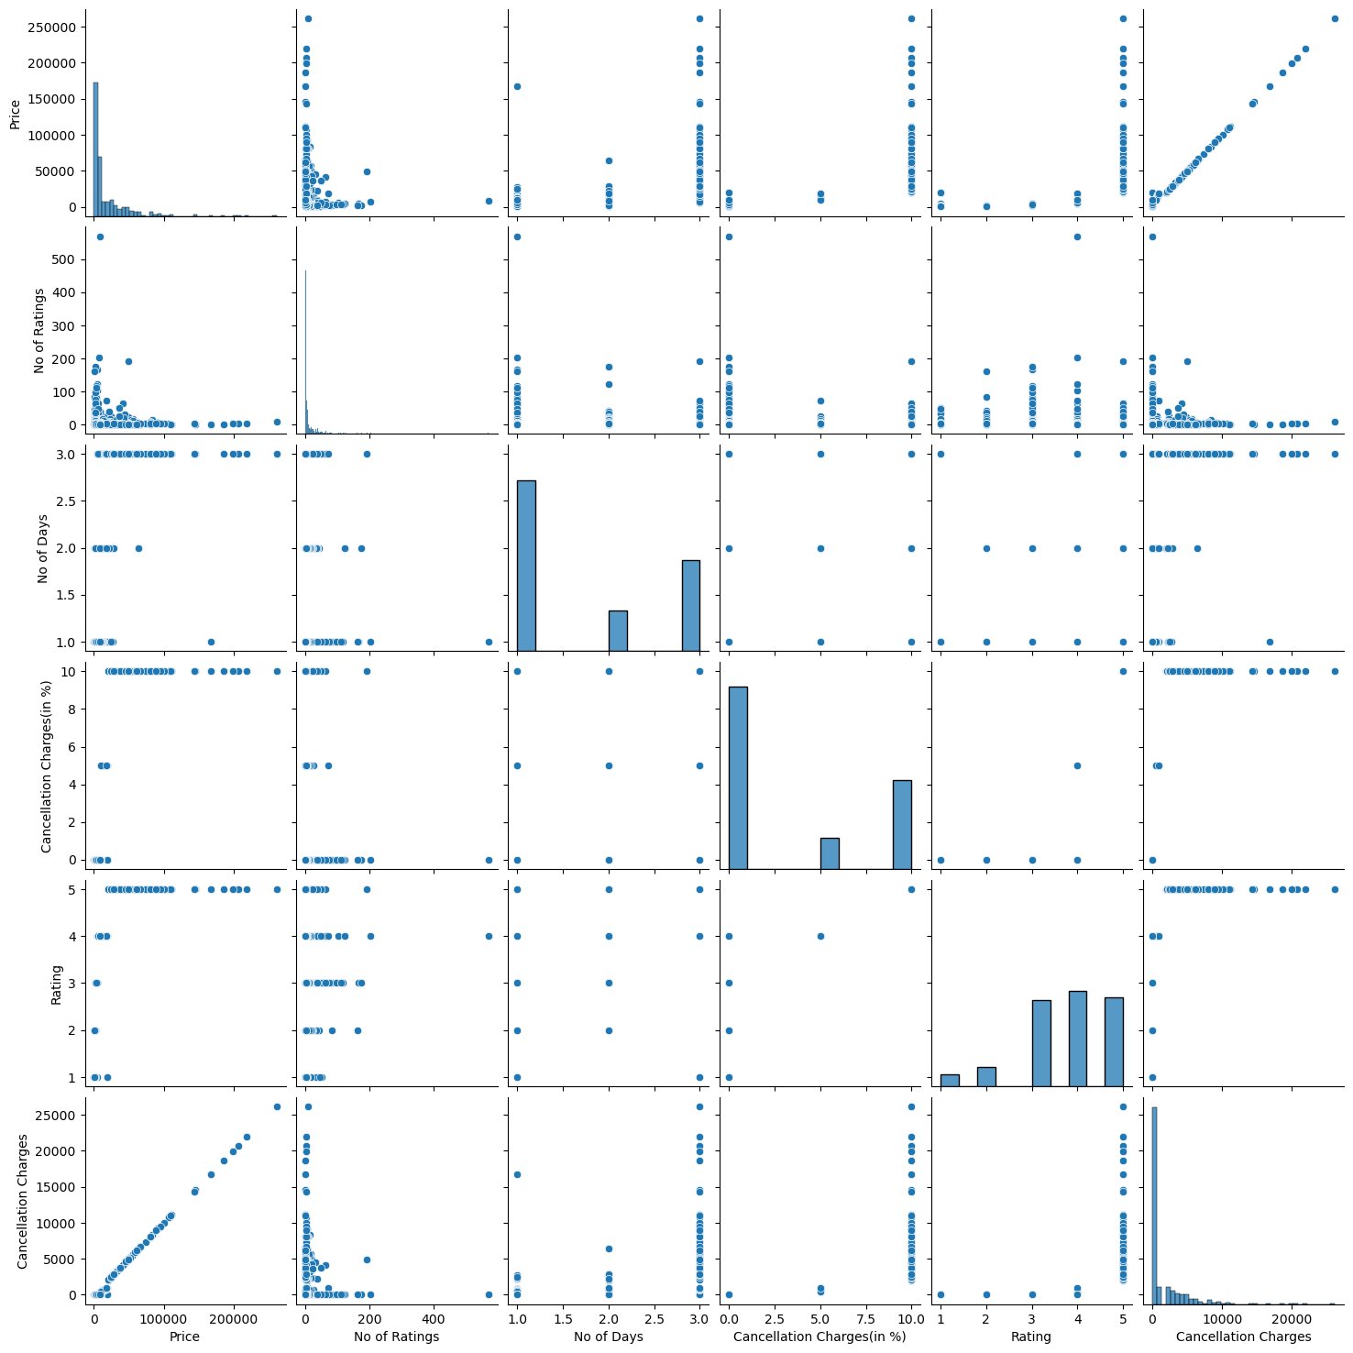

Slide 20
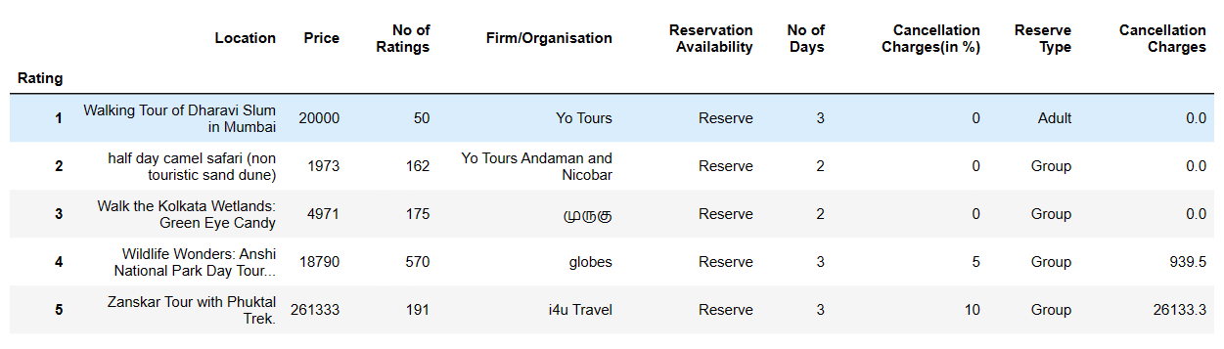
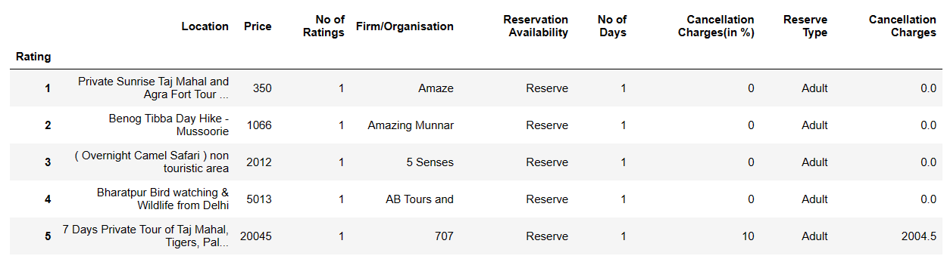
Max & Min Prices Based on Ratings
Below are the Maximum Prices Based upon their respective Ratings
Below are the Minimum Prices Based upon their respective Ratings

Slide 21
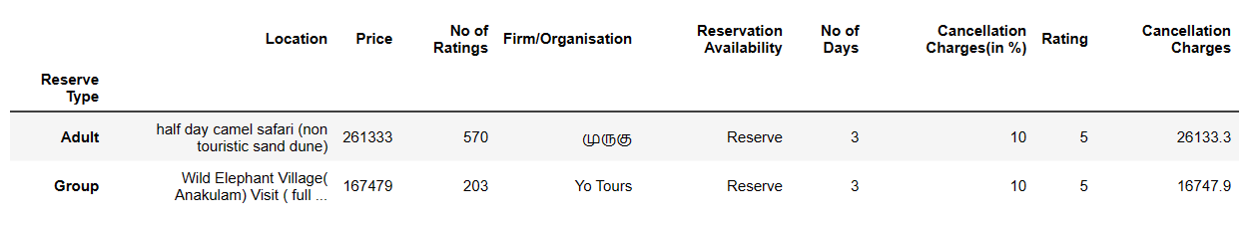
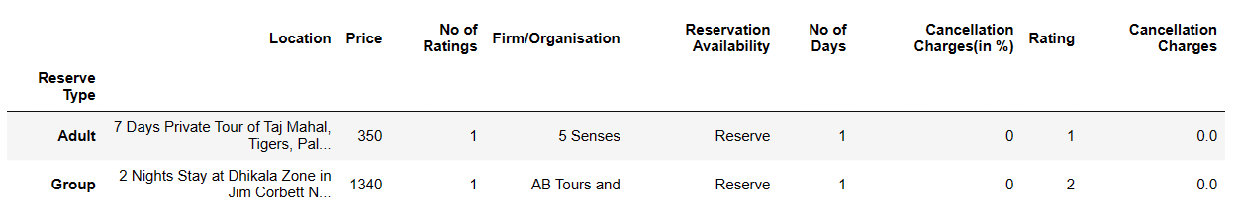
Reserve Type Max & Min
Maximum Prices of the Reserves/Tours for the Group and Adult Reserve Type.
Minimum Prices for the Reserves/Tours for the Group and Adult Reserve Type.

Slide 22
Conclusion
As per the complete Data Analysis we conclude that:-
The most of the people are preferring the One day tours which are budget friendly and best places to visit in.
Here in order to increase the Business for Group Reserve type we can target the youth , schools, Corporates and Joint families and announce some special packages for them and increase the Business.
whereas the 2&3 day tours are little bit costlier , Here we can target the working professionals and Wealth segment and announce some special Packages ,and decrease the Cancellation charges in order to increase the Business.

Slide 23
Our Experience /Challenges Working on Web Scrapping – Data Analysis Project.
The initial problem we faced was we couldn’t find the correct Website where we’re unable to Scrape the complete data.
We felt little bit difficulty in scrapping the data from the container using the Regex.
One of the major difficulty we faced with cleaning of the Data and Data types Conversion.

Slide 24

THANK YOU

